Slide 1
ChIP-seq and ATAC-seq
Chris Miller, Ph.D.
Washington University in St. Louis
Some slides adapted from:
https://github.com/genome/bfx-workshop https://github.com/quinlan-lab/applied-computational-genomics

Slide 2
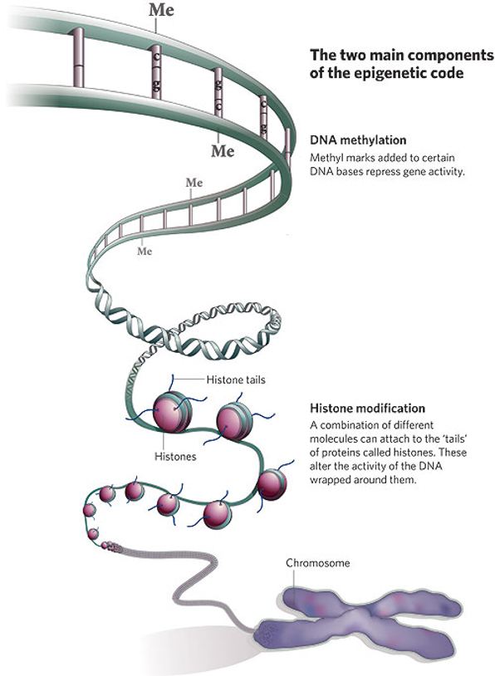
ChIP-seq/ATAC-seq
Alterations of DNA state or accessibility
Wrapped around histones
Bound by transcription factors
etc

Slide 3
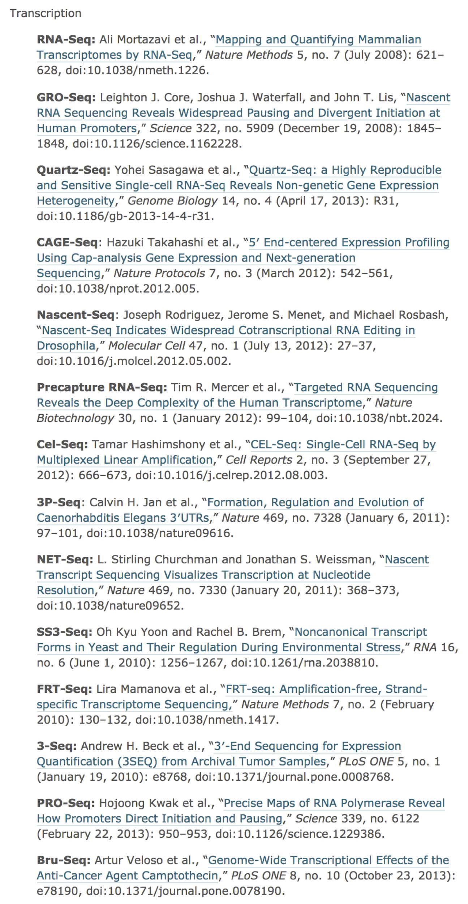
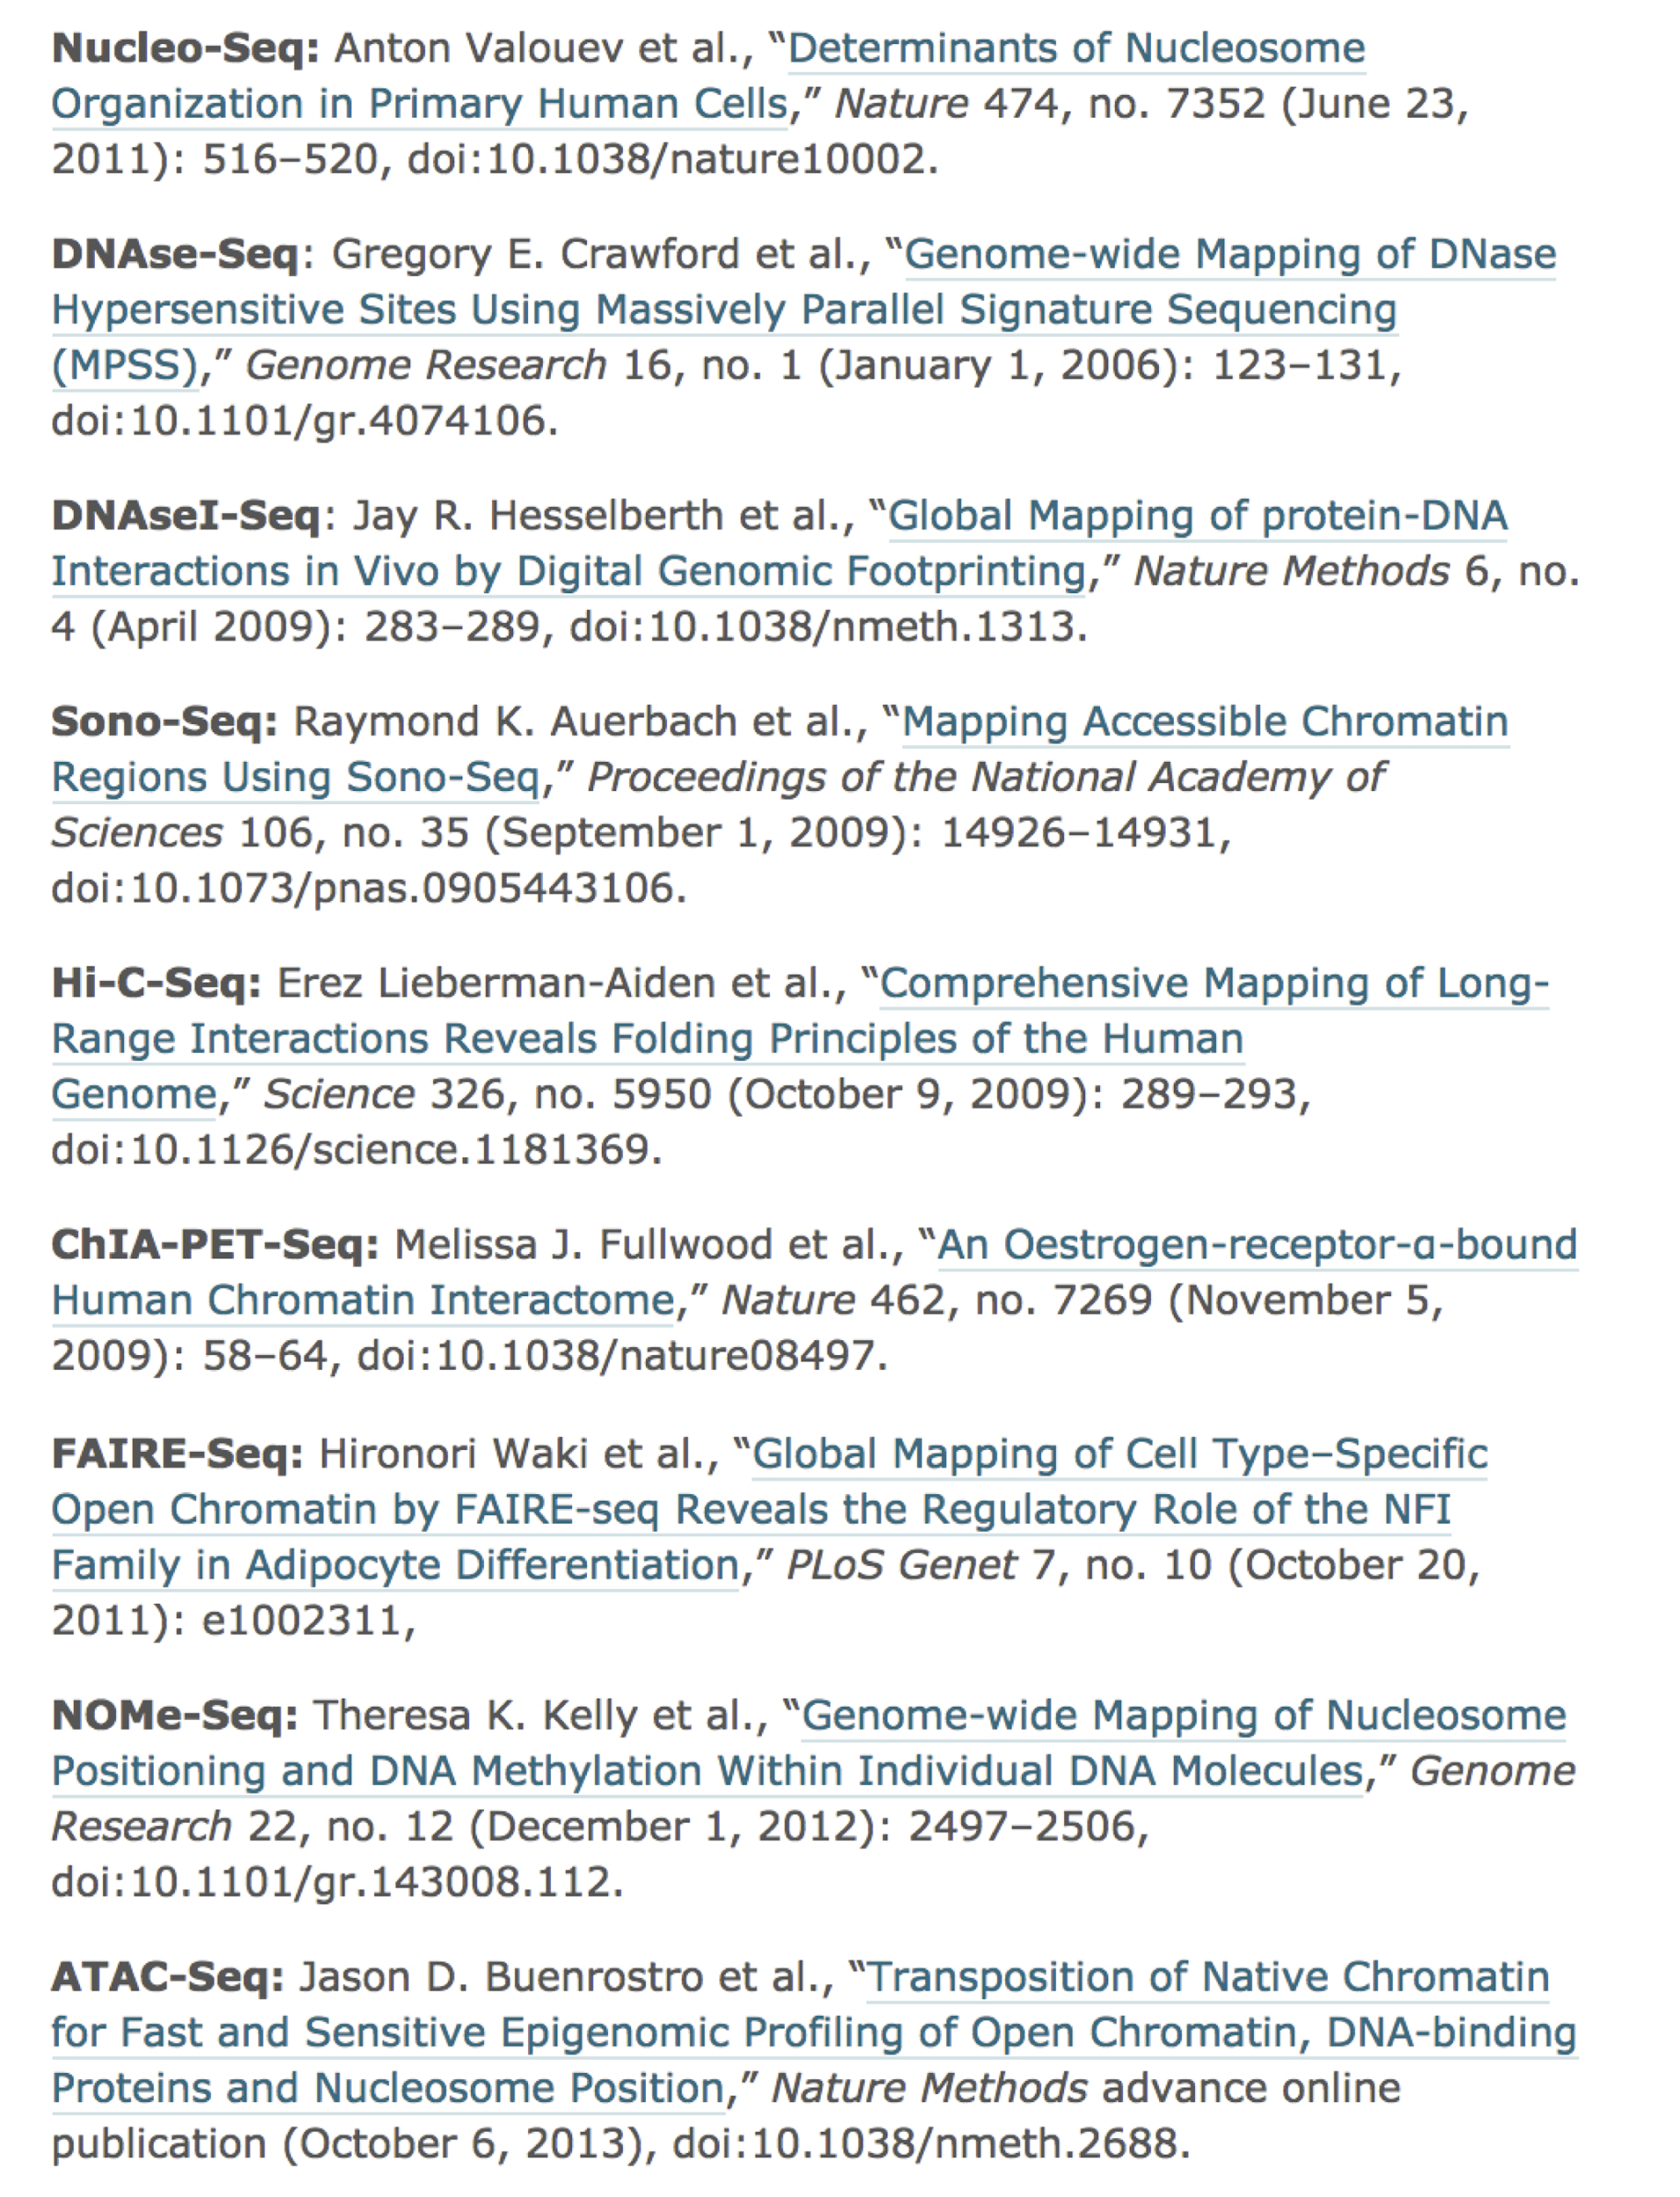
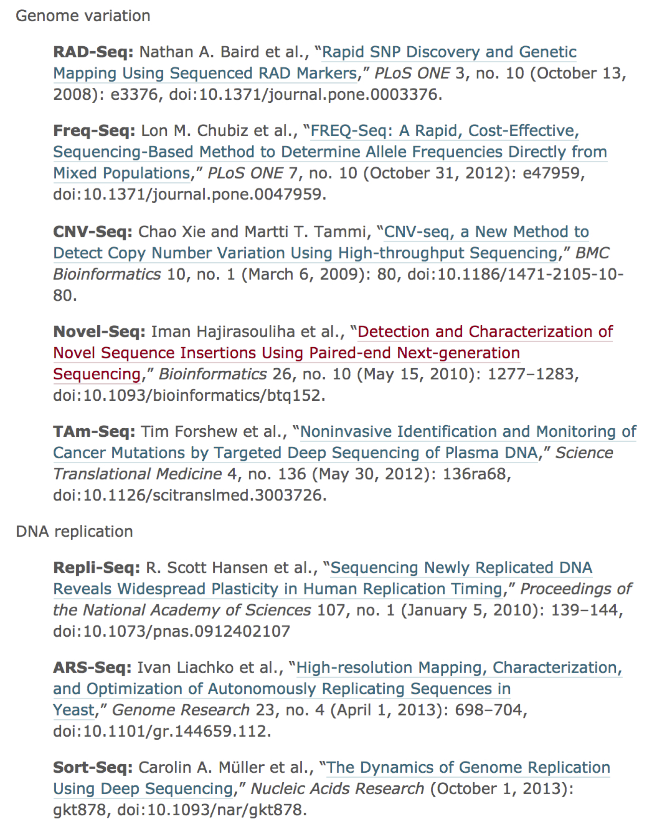
105+ *-seq assays
from Lior Pachter’s blog

Slide 4
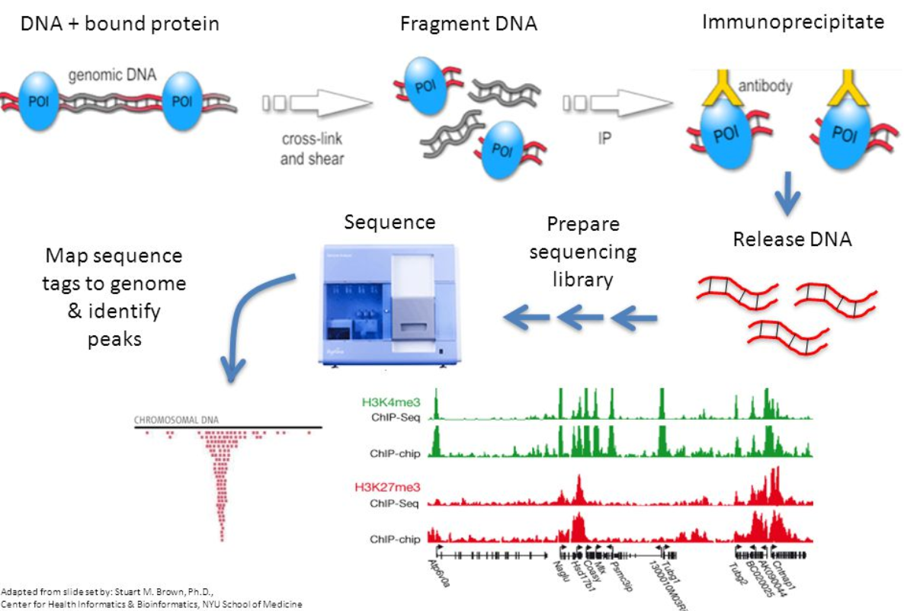
ChIP-seq

Slide 5
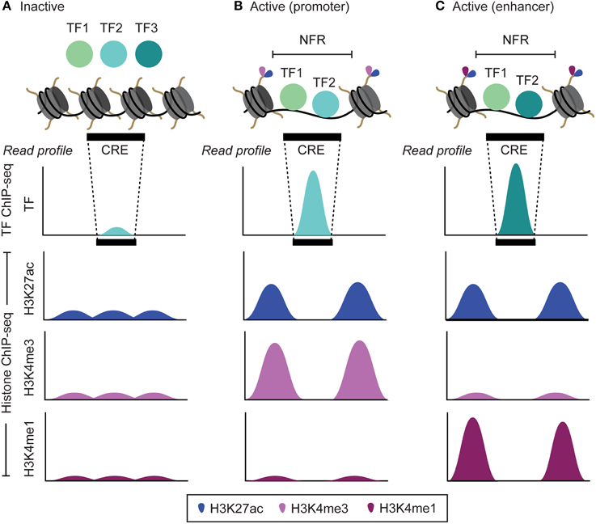
Mapping transcription-factor binding locations
NFR = nucleosome free region
CRE = Cis regulatory element
http://journal.frontiersin.org/article/10.3389/fgene.2015.00188/full
Notes:
CRE = enhancer or promotor

Slide 6
Mapping histone modifications
NFR = nucleosome free region
http://journal.frontiersin.org/article/10.3389/fgene.2015.00188/full

Slide 7
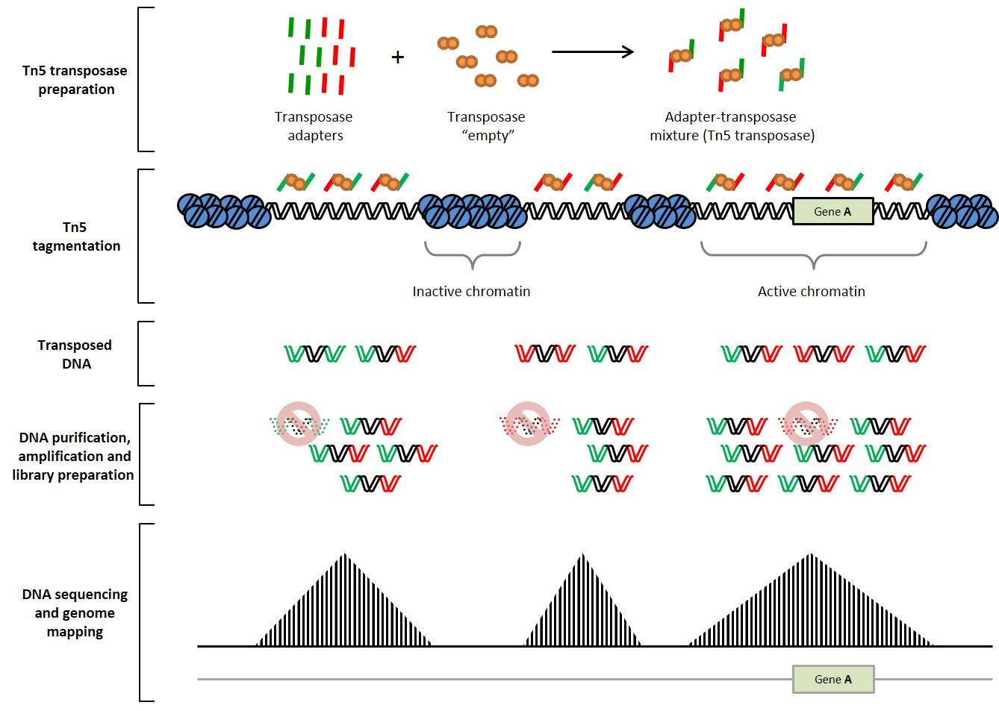
ATAC-seq DNA accessibility
https://www.youtube.com/watch?v=OjFFPIENrWQ

Slide 8
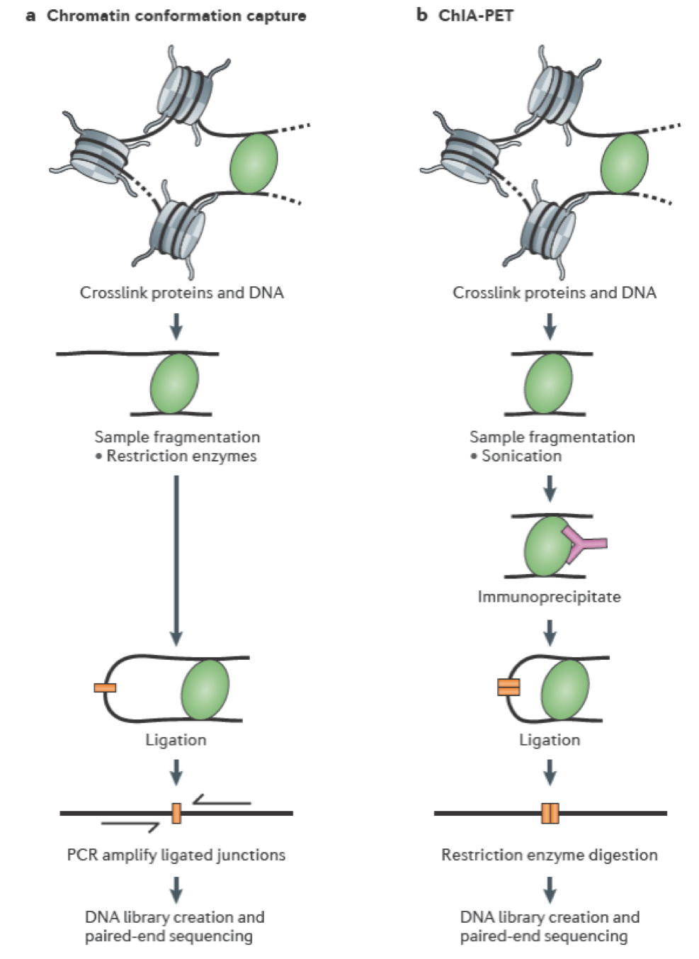
Examining 3-D DNA interactions in the nucleus
Nature Reviews Genetics 2012 13:840

Slide 9
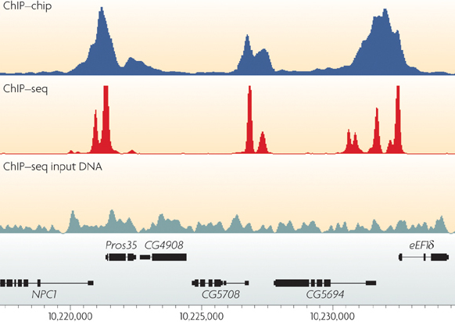
Peak-calling
Fundamentally a
signal vs noise problem
Nature Reviews Genetics 10, 669-680 (October 2009)

Slide 10
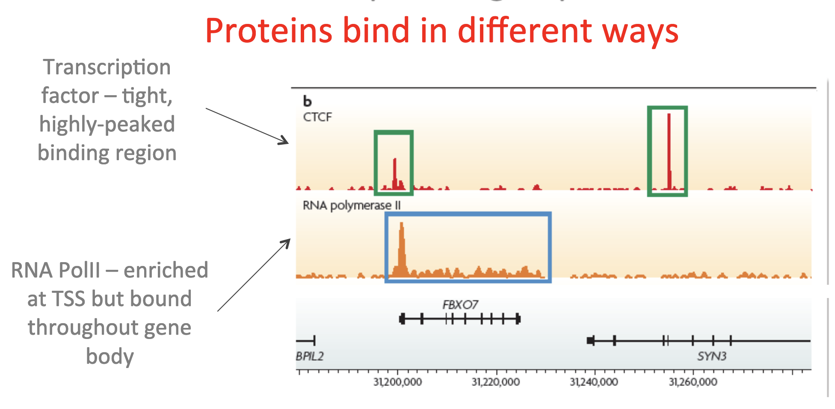
https://www.ebi.ac.uk/sites/ebi.ac.uk/files/content.ebi.ac.uk/materials/2013/131021_HTS/introduction_to_chip_seq_data_and_analysis-b.gerle_.pdf

Slide 11
How much sequence coverage do we need?
For mammalian TFs, chromatin mods like enhancer-associated histone marks:
have on the order of thousands of binding sites,
20 million reads may be adequate
(4 million reads for worm and fly TFs).
https://www.ebi.ac.uk/sites/ebi.ac.uk/files/content.ebi.ac.uk/materials/2013/131021_HTS/introduction_to_chip_seq_data_and_analysis-b.gerle_.pdf

Slide 12
How much sequence coverage do we need?
More binding sites (e.g., RNA Pol II) or broader factors, including most histone marks,
- require more reads, up to 60 million for mammalian ChIP-seq.
https://www.ebi.ac.uk/sites/ebi.ac.uk/files/content.ebi.ac.uk/materials/2013/131021_HTS/introduction_to_chip_seq_data_and_analysis-b.gerle_.pdf

Slide 13
How much sequence coverage do we need?
Importantly, control samples should be sequenced significantly deeper than the ChIP ones in a TF experiment and in experiments involving diffused broad-domain chromatin data. This is to ensure sufficient coverage of a substantial portion of the genome and non-repetitive autosomal DNA regions.
https://www.ebi.ac.uk/sites/ebi.ac.uk/files/content.ebi.ac.uk/materials/2013/131021_HTS/introduction_to_chip_seq_data_and_analysis-b.gerle_.pdf

Slide 14
ChIP-seq statistics
Continuous variables:
Your exact height
Your dog's exact weight
The winning time in a race
Exact distance between stars
Your exact age
Time it takes a computer to complete a task.
Discrete variables:
The number of lightbulbs that burnout in a warehouse in a given week.
The number of heads when flipping a coin 50 times.
The number of students in a class
The number of times you forget the attachment to an email on Fridays.
The number of green M&Ms in a bag
The number of times a given base is sequenced.

Slide 15
The Poisson distribution: discrete distribution to model coverage
P(k discrete events) = λ^{k}e^{k} / k!
Where e is Euler's constant (2.718), and ƛ is the average number of occurrences of an event
Example: the "hundred year flood". Thus ƛ=1 (1 catastrophic flood every 100 years

Slide 16
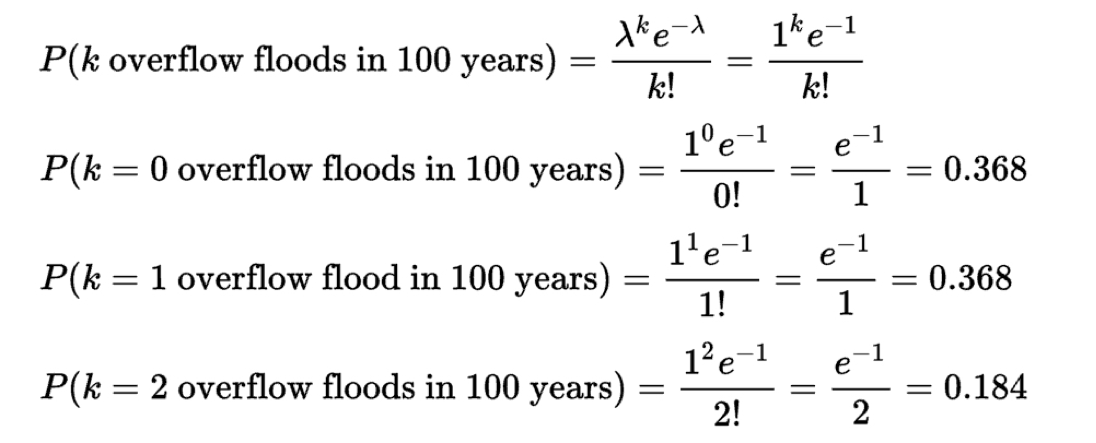
Example: the "hundred year flood". Thus ƛ=1 (1 catastrophic flood every 100 years
k | P(k overflow floods in 100 years)
0 | 0.368
1 | 0.368
2 | 0.184
3 | 0.061
4 | 0.015
5 | 0.003
6 | 0.0005
https://en.wikipedia.org/wiki/Poisson_distribution

Slide 17
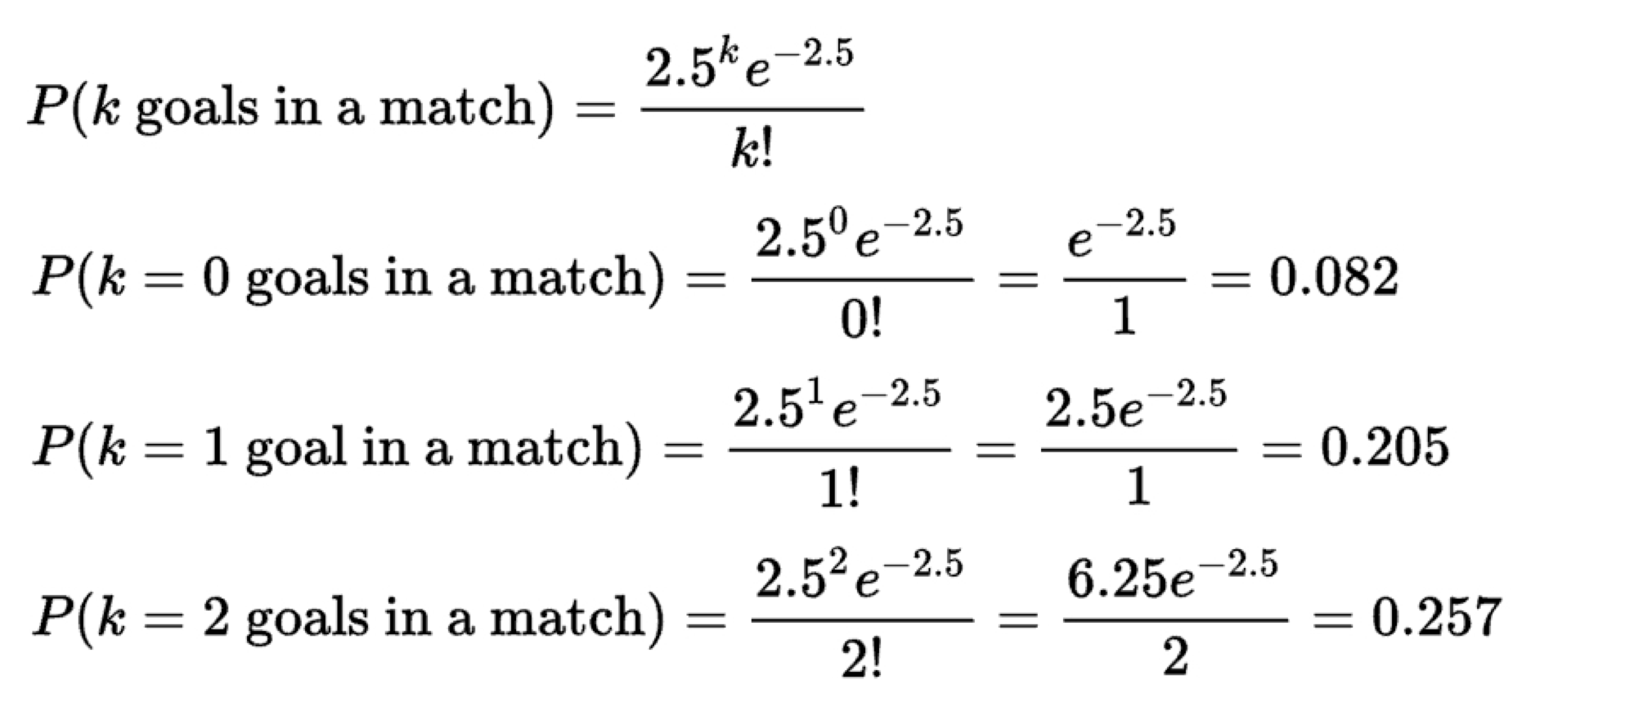
Example: expected number of goals in a World Cup game. Average number of goals is 2.5
k | P(k goals in a World Cup soccer match)
0 | 0.082
1 | 0.205
2 | 0.257
3 | 0.213
4 | 0.133
5 | 0.067
6 | 0.028
Note that ƛ does not have to be a countable integer.
https://en.wikipedia.org/wiki/Poisson_distribution

Slide 18
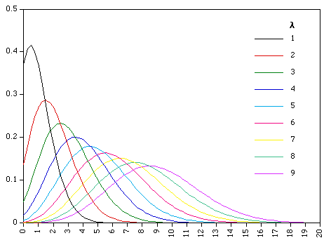
Poisson distribution with different values of ƛ
https://www.umass.edu/wsp/resources/poisson/

Slide 19
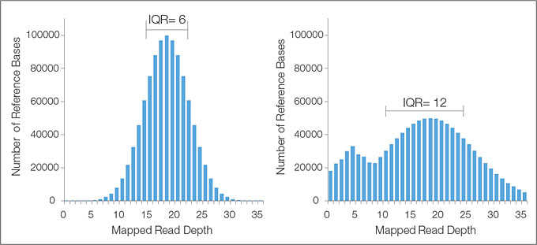
Ideally, sequencing coverage will follow a Poisson distribution. But...
Poisson
Not Poisson.
Overly "dispersed"
https://www.umass.edu/wsp/resources/poisson/

Slide 20
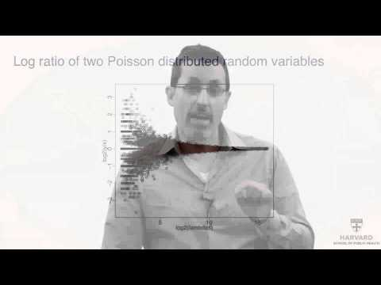
Negative binomial fits sequencing coverage data much better. Ask Rafael Irizarry
https://www.umass.edu/wsp/resources/poisson/

Slide 21
Comparative ChIP-seq: scaling and normalizing
Sequencing depths from TF ChIP should be compared to control (input DNA) to get a sense of the noise.
When comparing to ChIP-seq experiments, you need to normalize the counts / peaks before doing so. E.g., comparing experiments where one had 10 million reads and the other had 100 million reads.
Nature Reviews Genetics 10, 669-680 (October 2009)

Slide 22
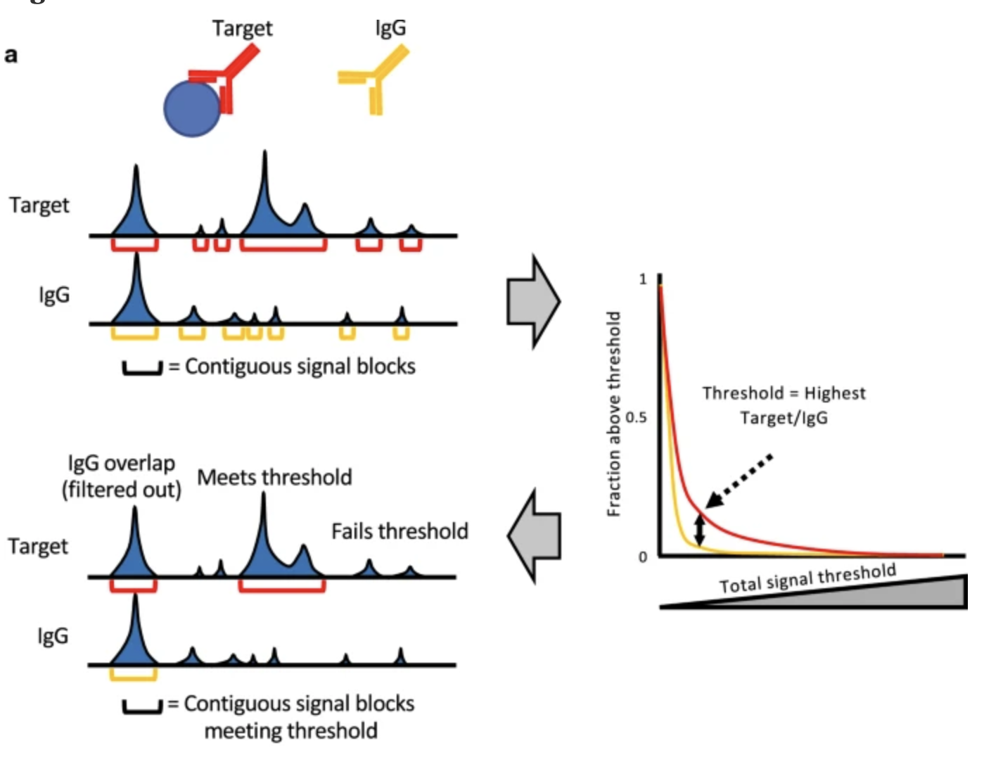
Peak-calling
MACS2, HOMER, SEACR, etc

Slide 23
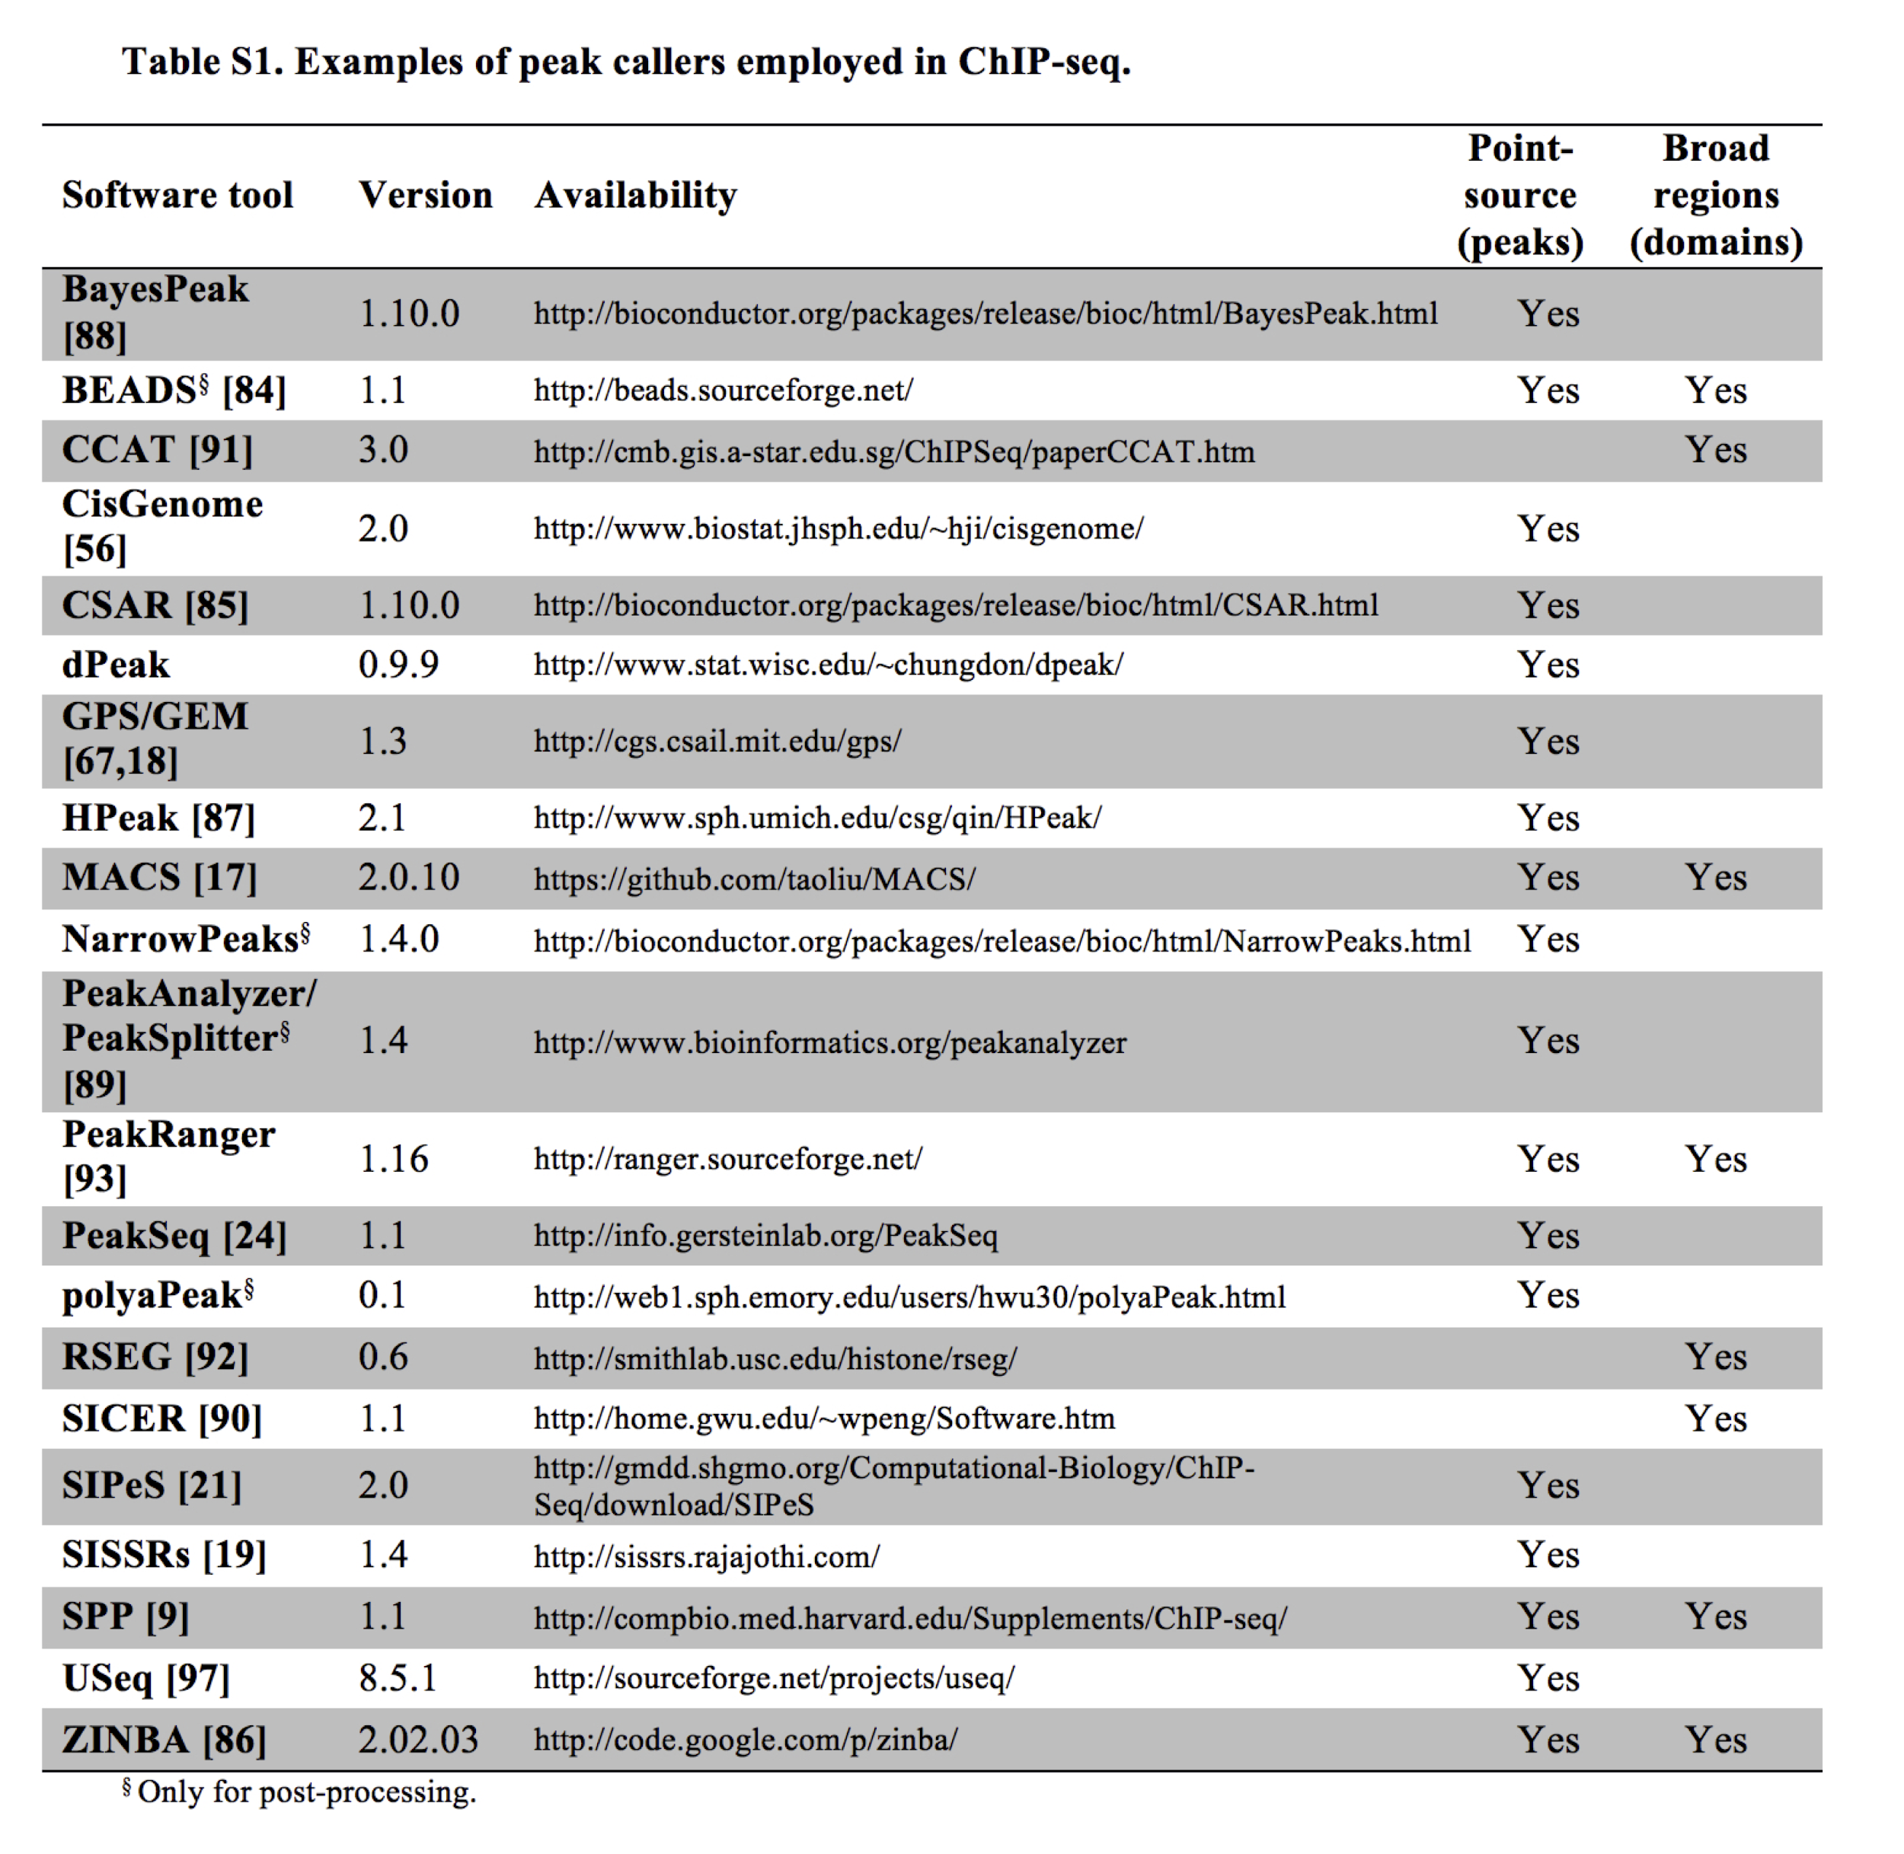
ChIP-seq peak callers
MACS is probably the most widely used
http://journals.plos.org/ploscompbiol/article?id=10.1371/journal.pcbi.1003326

Slide 24
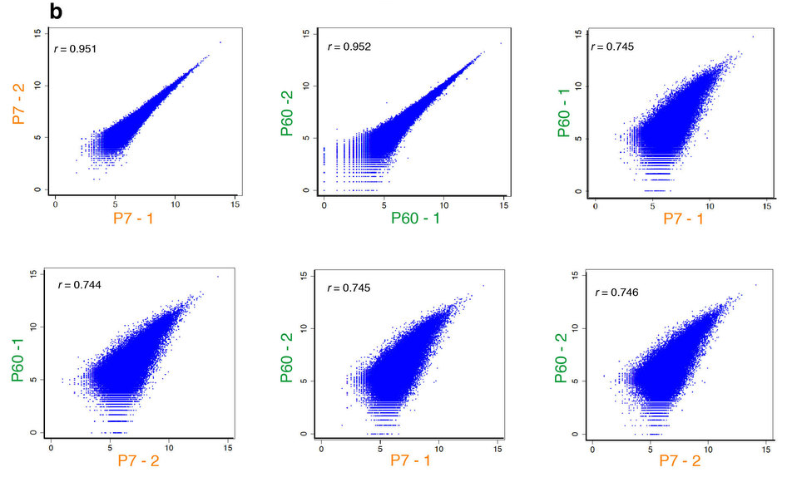
Replicates, replicates, replicates
Pearson Correlation is one metric indicative of overall reproducibility
(b) Scatterplots of pairwise Zic ChIP-seq replicates with Pearson correlation (r) displayed. Note the correlations are much higher between biological replicates of the same developmental stage than between P7 and P60 cerebellum.
http://www.nature.com/neuro/journal/v18/n5/full/nn.3995.html

Slide 25
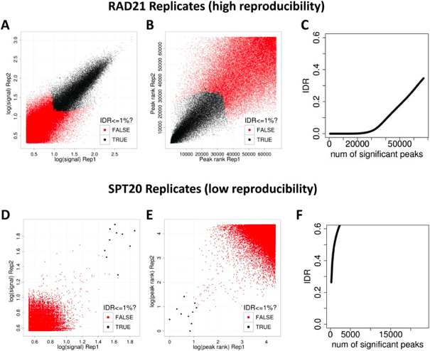
Irreproducibility Discovery Rate (IDR)
Peaks that show up consistently among replicates are more likely to be real!
Fantastic resource for learning ChIP-seq analysis
https://github.com/hbctraining/Intro-to-ChIPseq

Slide 26
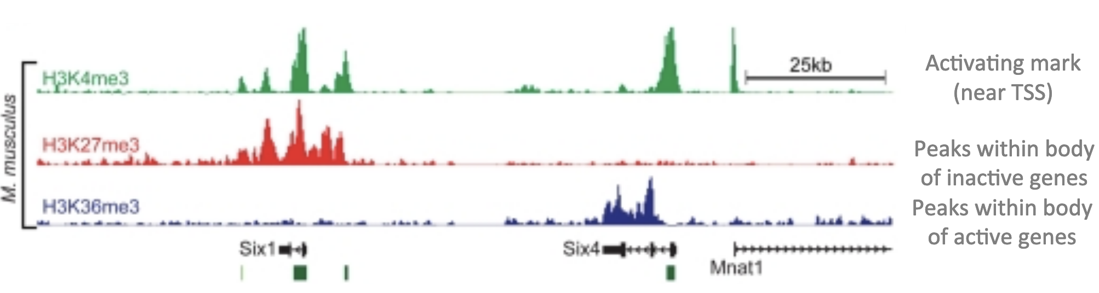
Interpretation
https://www.ebi.ac.uk/sites/ebi.ac.uk/files/content.ebi.ac.uk/materials/2013/131021_HTS/introduction_to_chip_seq_data_and_analysis-b.gerle_.pdf

Slide 27
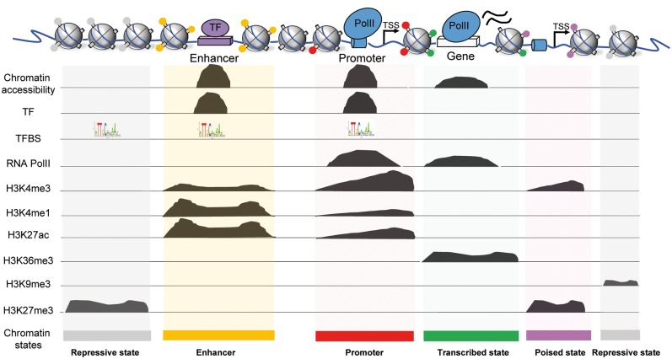
https://www.ncbi.nlm.nih.gov/pmc/articles/PMC5888983/

Slide 28
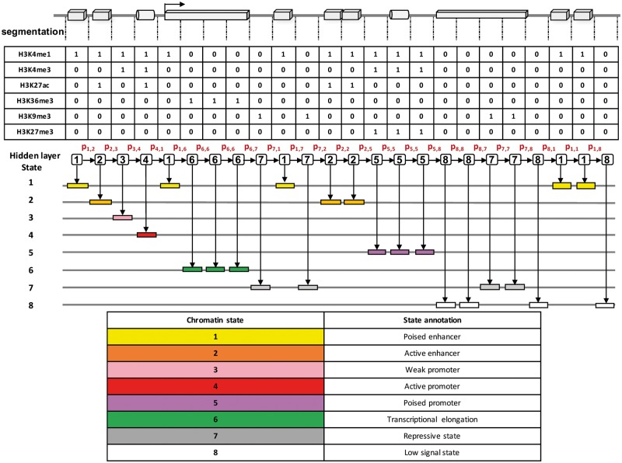
Genome Segmentation
with ChromHMM
Be aware that segmentation may be tissue or cell-type specific!
https://www.ncbi.nlm.nih.gov/pmc/articles/PMC5888983/

Slide 29
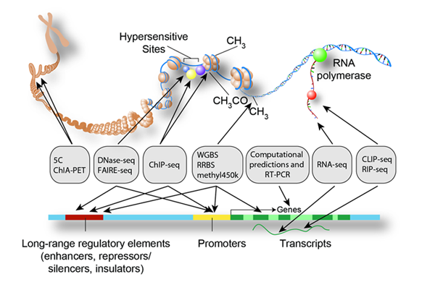
The Encyclopedia of DNA Elements Project
https://www.encodeproject.org/

Slide 30
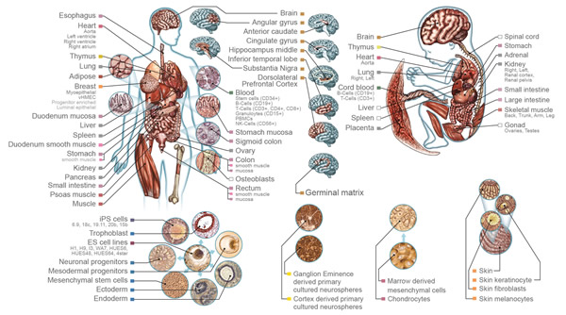
Roadmap Epigenomics Project
http://commonfund.nih.gov/epigenomics/index

Slide 31
Bisulfite sequencing
Chris Miller, Ph.D.
Washington University in St. Louis
Some slides adapted from:
https://github.com/genome/bfx-workshop https://github.com/quinlan-lab/applied-computational-genomics

Slide 32
Epigenetics

Slide 33
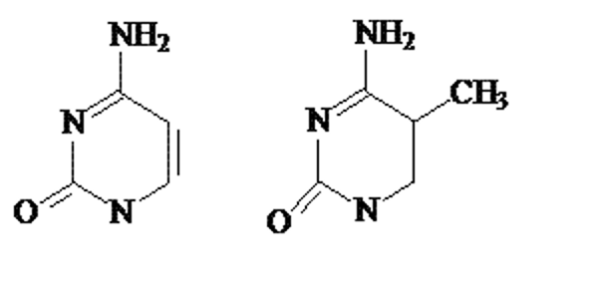
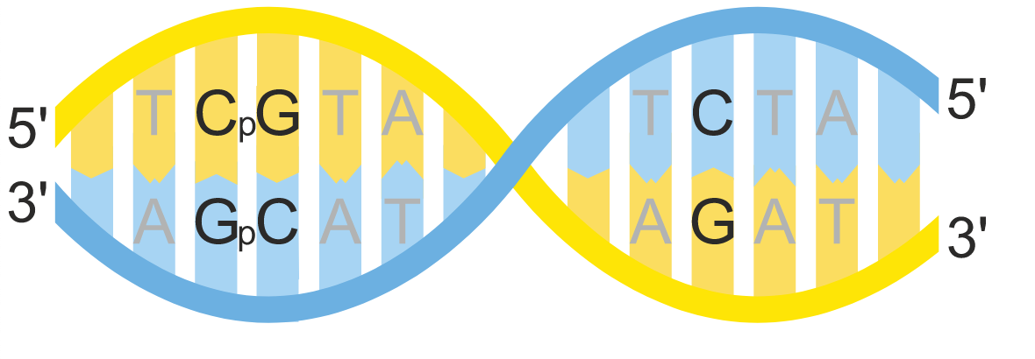
DNA Methylation
Mostly happens at CpGs
About 25 million CpGs in human genome
https://en.wikipedia.org/wiki/CpG_site#/media/File:CpG_vs_C-G_bp.svg

Slide 34
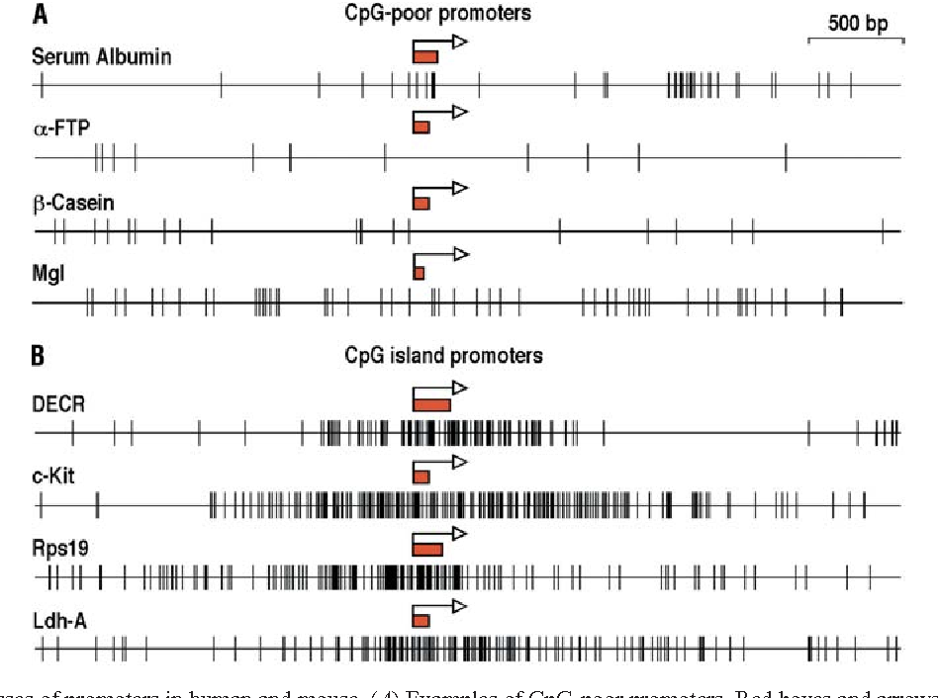
DNA Methylation
CpG Islands
Length >= 200 bp GC% > 50% o/e CpG ratio > 60%
Selective pressure/ Evolutionary constraint
DOI:10.1007/s00018-003-3088-6

Slide 35
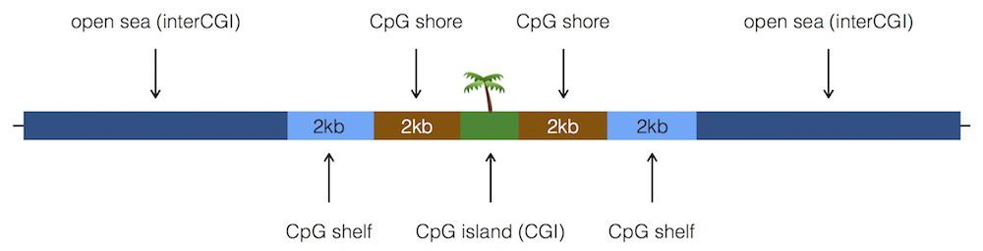
Islands, shores, and shelves
https://bioconductor.org/packages/release/bioc/vignettes/annotatr/inst/doc/annotatr-vignette.html

Slide 36
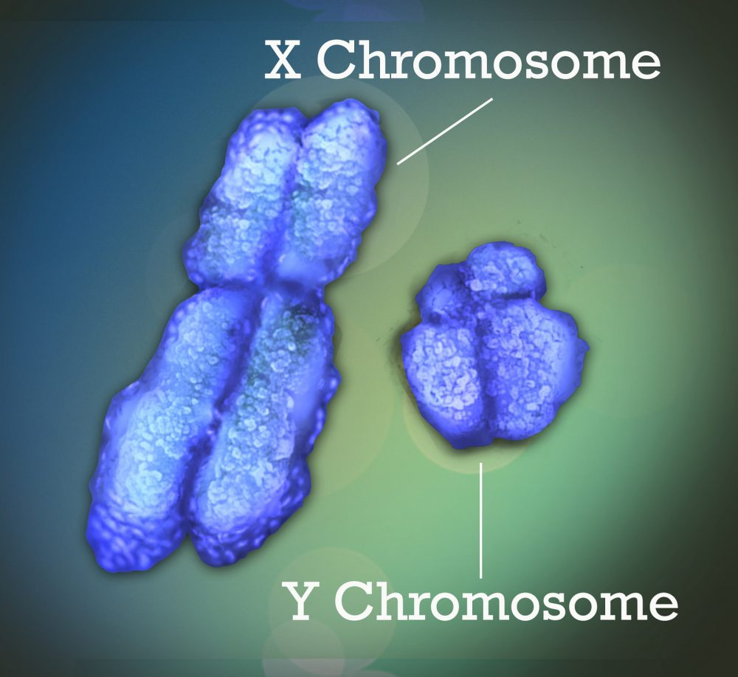
What does DNA methylation do?
The short answer: It depends!
X-chromosome inactivation
Silencing of transposable elements
Cellular differentiation
Cancer - hypo/hypermethylation

Slide 37
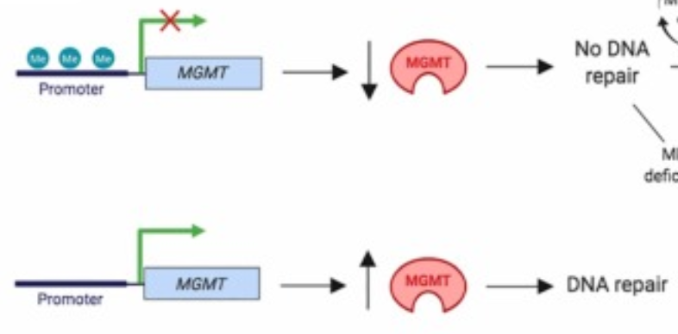
MGMT and Temozolomide
TMZ is an alkylating agent - damages DNA, causes cell death
MGMT “cleans up” the damage
Methylation of the MGMT promoter is linked to better outcomes!

Slide 38
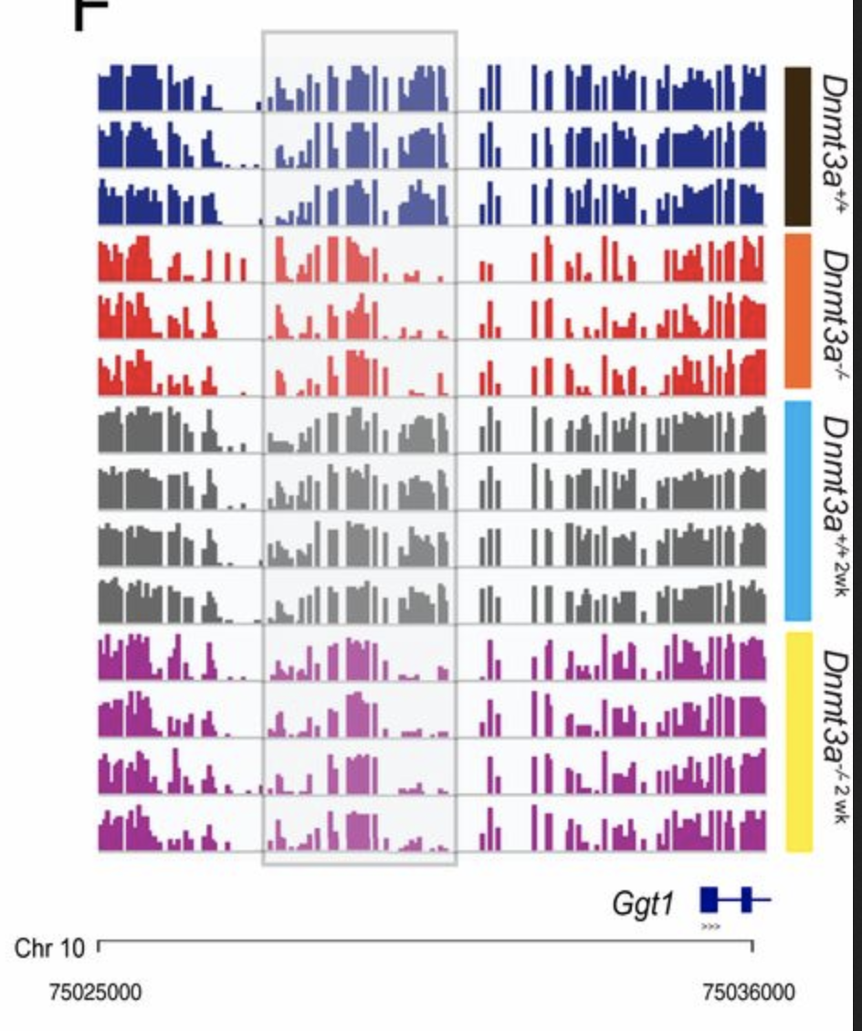
Methylation Patterns
Methyltransferases that act locally

Slide 39
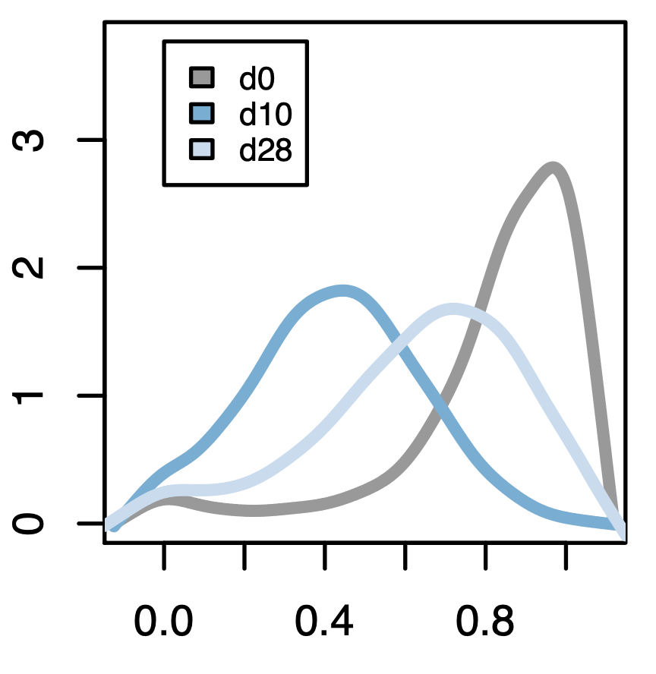
Methylation Patterns
Methyltransferases that act locally
Other alterations (or treatments) that act globally

Slide 40
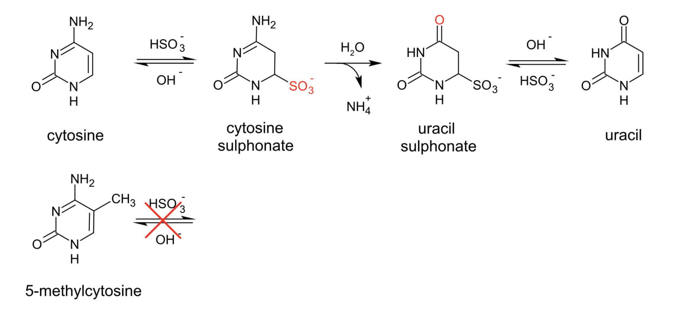
Bisulfite sequencing
https://en.wikipedia.org/wiki/File:Bisulfite_conversion.svg

Slide 41
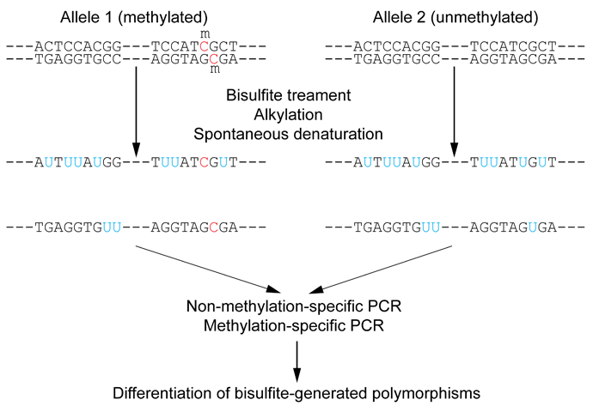
Bisulfite sequencing
https://en.wikipedia.org/wiki/File:Wiki_Bisulfite_sequencing_Figure_1_small.png

Slide 42
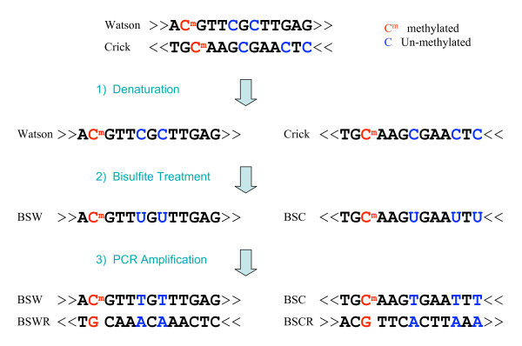
Bisulfite sequencing
BSMAP: whole genome bisulfite sequence MAPping program. BMC Bioinformatics 10:232

Slide 43
Whole-genome Bisulfite Sequencing (WGBS)
Need a special aligner - has to expect many C > T mismatches!
BSMAP
bismark
BWA-meth
biscuit

Slide 44
Methylation calling
Determine methylation fraction at each site in the genome
Count the Cs and Ts, taking strandedness into account
Some tools account for SNPs while doing this

Slide 45
Methylation calling
Determine methylation fraction at each site in the genome
Count the Cs and Ts, taking strandedness into account
Some tools account for SNPs while doing this
Why isn’t every position 0%, 50% or 100%?

Slide 46
Methylation calling
Determine methylation fraction at each site in the genome
Count the Cs and Ts, taking strandedness into account
Some tools account for SNPs while doing this
Why isn’t every position 0%, 50% or 100%?
we’re sequencing a population of cells!

Slide 47
Workflow/File formats
Aligning: FASTQ > BAM/CRAM
Pileup: BAM/CRAM > VCF
(entries for every site, allele frequencies)
VCF > bedgraph
chr, start, stop, beta_value (methylation fraction)
bedgraph > bigwig (for visualization in IGV)
There are workflows for this!

Slide 48
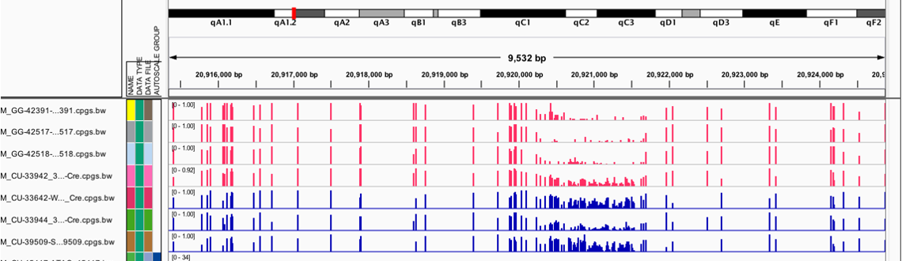
IGV visualization

Slide 49
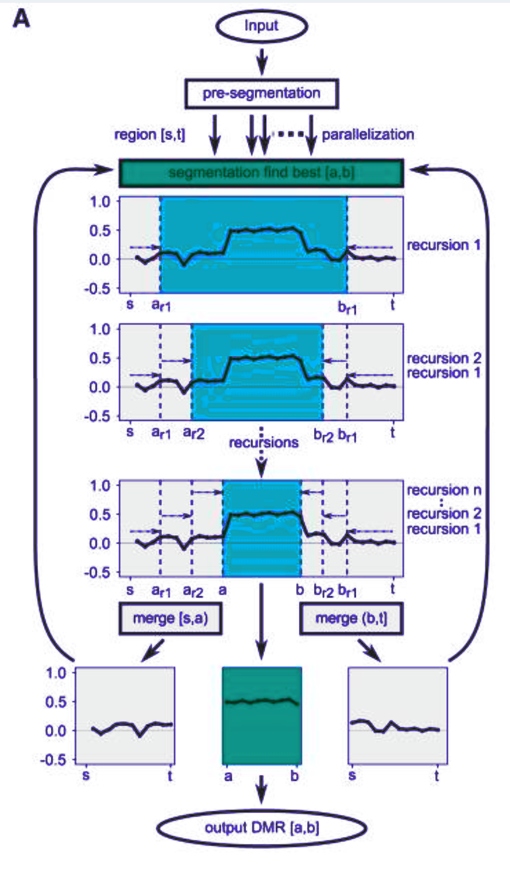
Differentially methylated regions
Comparing two groups to find changes
Finding DMRs is a segmentation problem
We use a tool called metilene
https://www.ncbi.nlm.nih.gov/pmc/articles/PMC4728377/

Slide 50
Differentially methylated regions

Slide 51
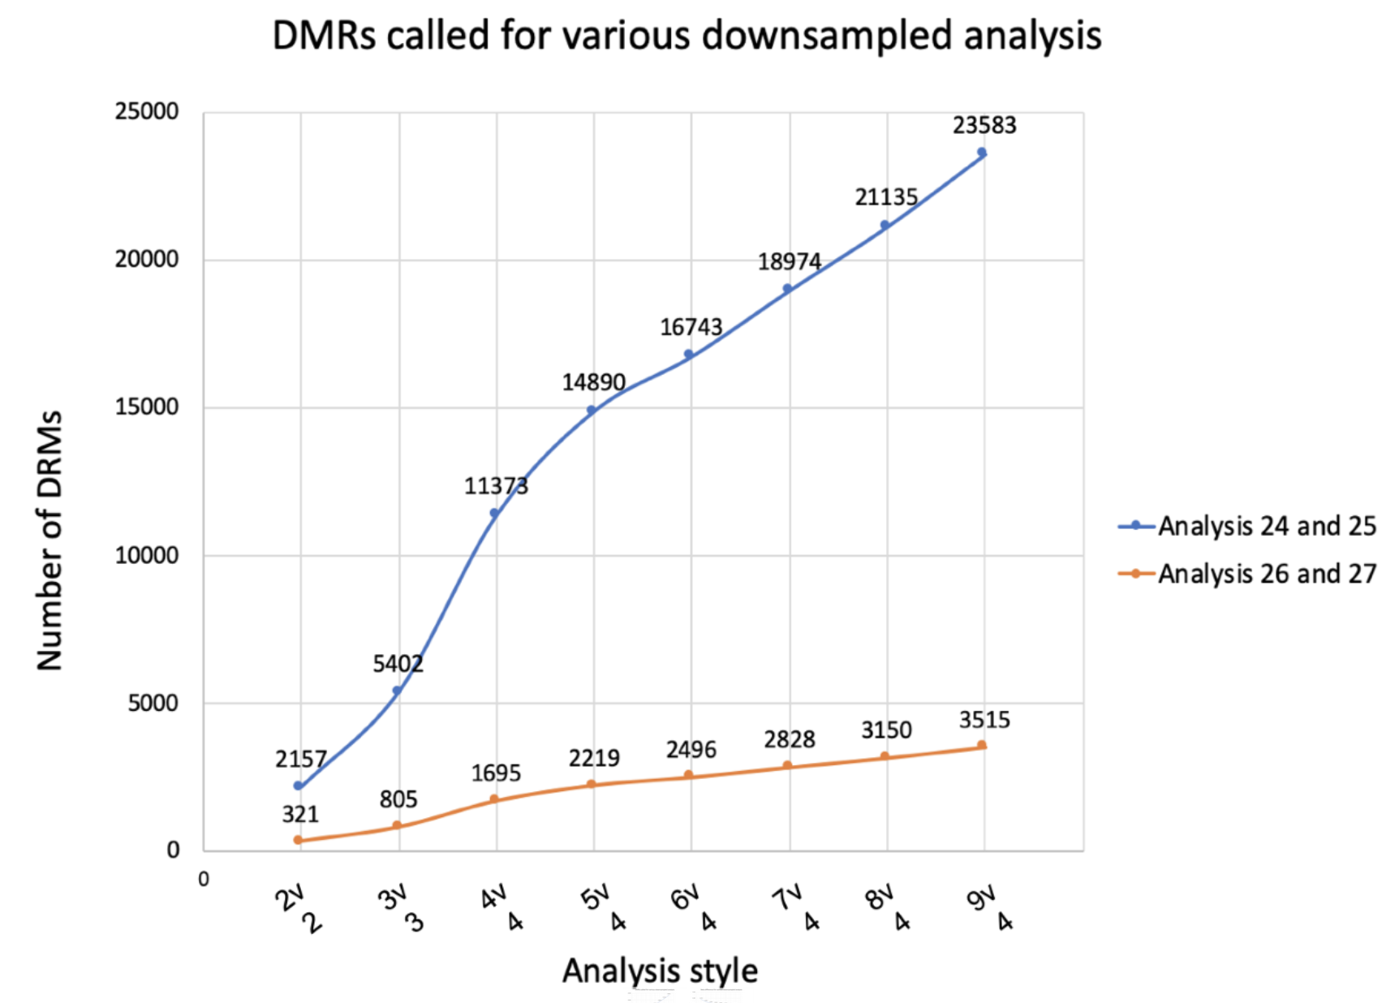
Number of samples matters!

Slide 52
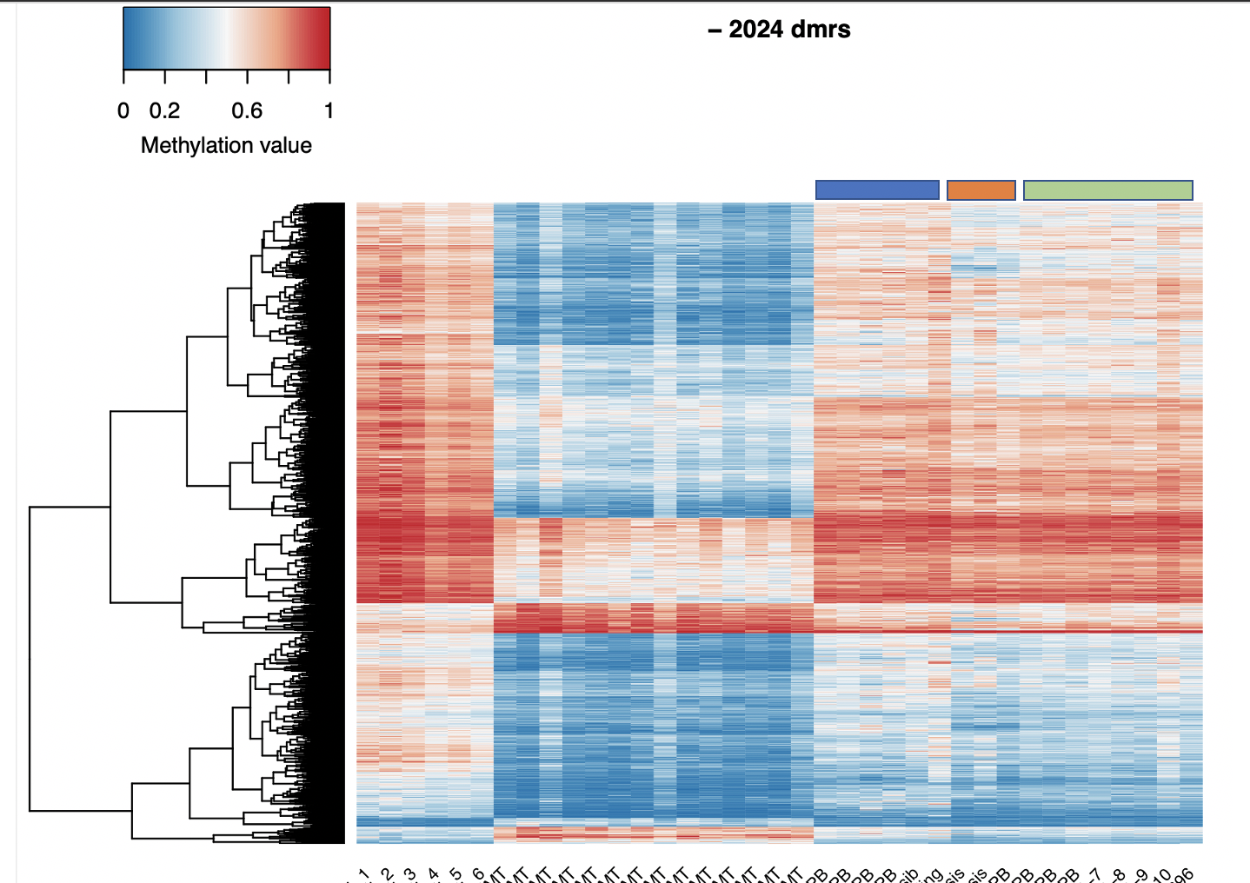
Heatmaps

Slide 53
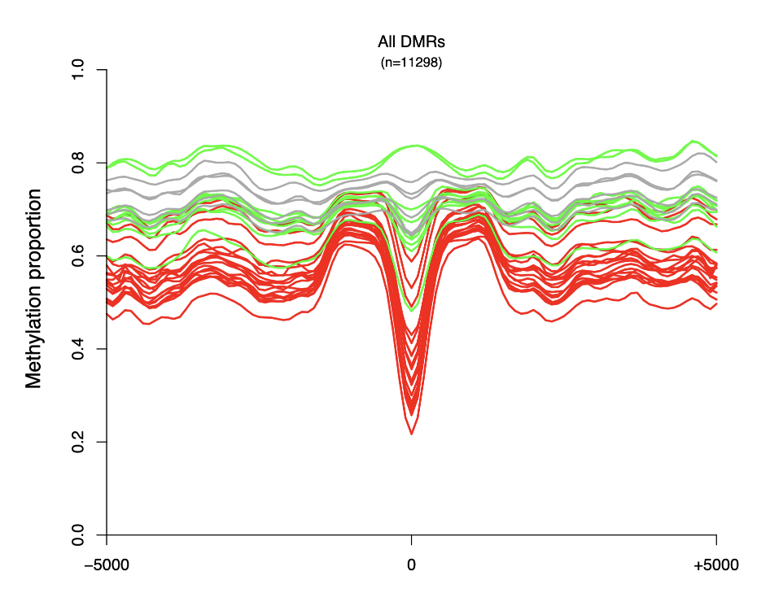
Canyon Plots

Slide 54
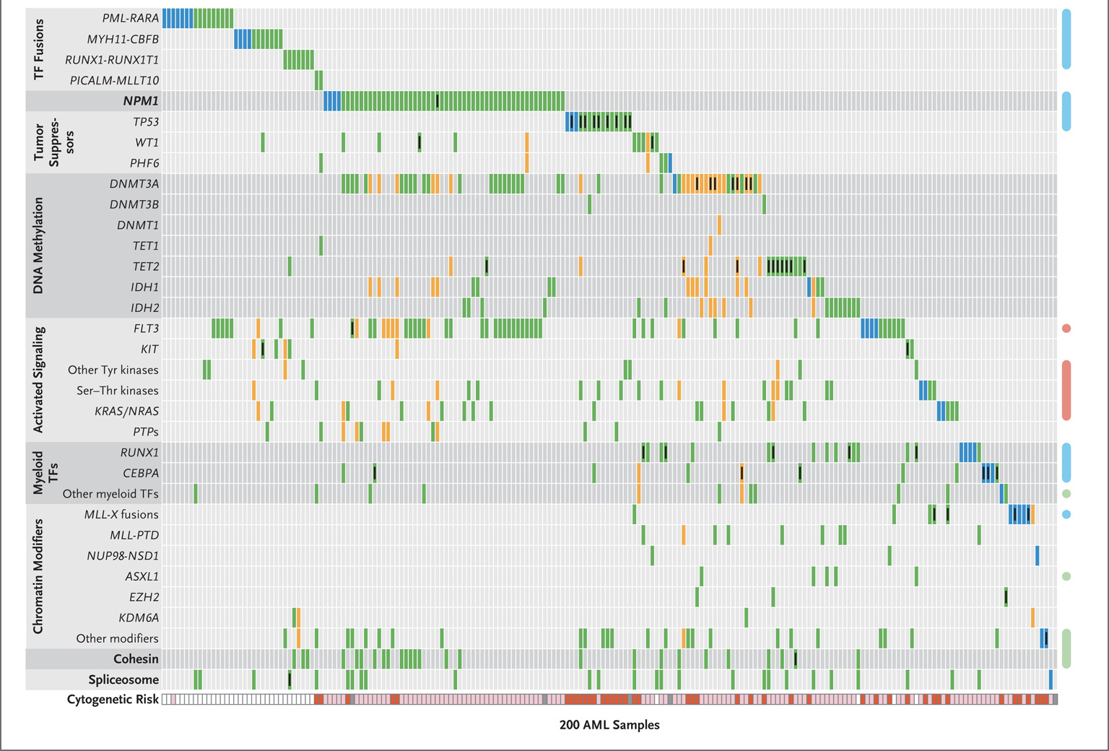
DNMT3A deficiency

Slide 55
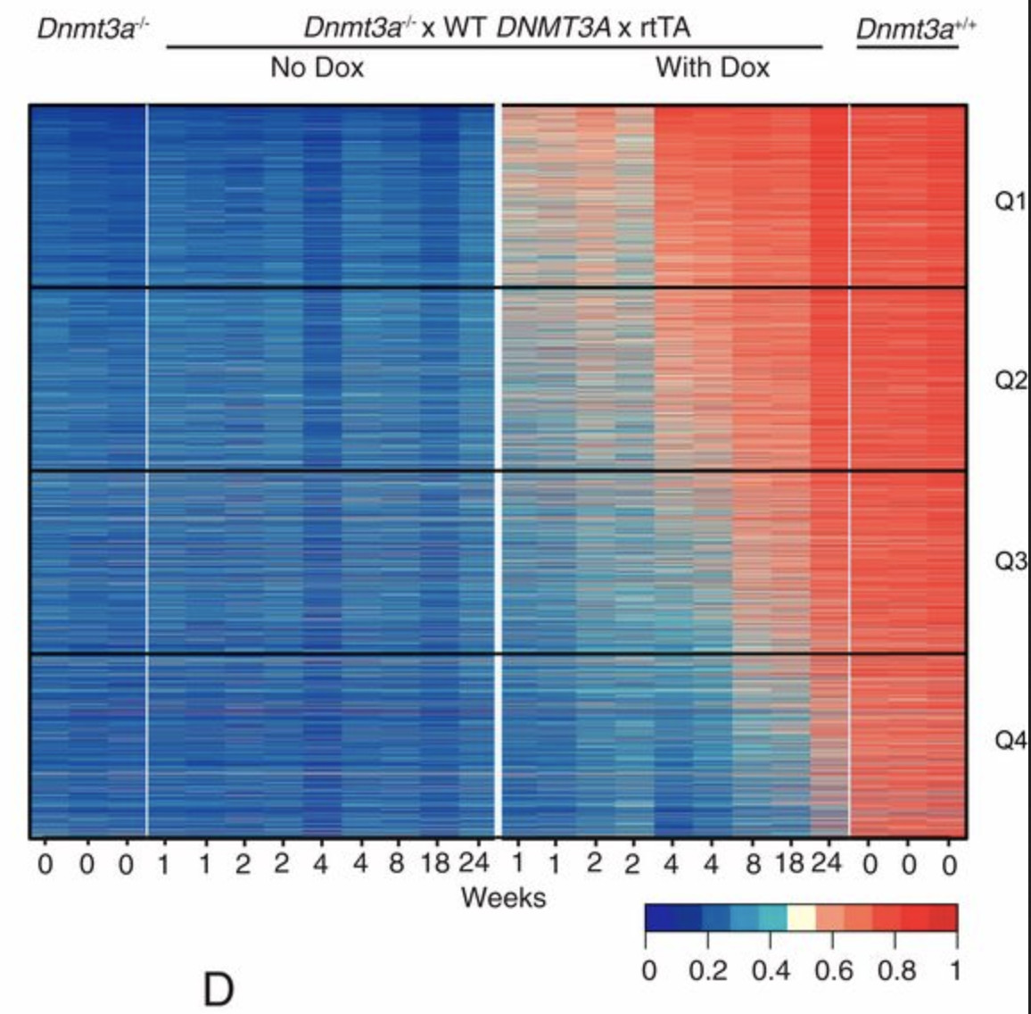
DNMT3A deficiency
Mouse models (and human data)
Looking at context, effects, and reversibility
https://www.pnas.org/content/117/6/3123.full

Slide 56
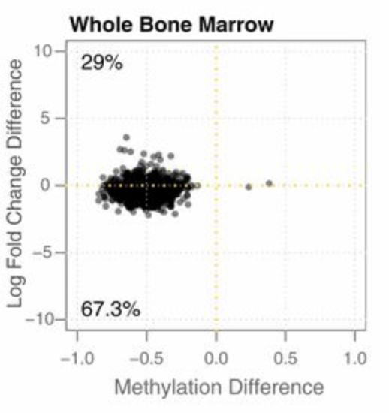
DNMT3A deficiency
Mouse models (and human data)
Looking at context, effects, and reversibility
https://www.pnas.org/content/117/6/3123.full

